Slide 1


Seminar
“SpaceX’s Starlink Constellation Program”
Network protocols in orbit: Building a space-based ISP
GUIDE:
Mrs. Rajani Kodagali, Asst. Prof
CSE Dept.
Presented By
HARIHARAN P – 1RG17CS017

Slide 2
Order of Explanation
What is Starlink project
How it works?
Advantages
Disadvantages
Starlink Developers Insight
When is it coming to India?

Slide 3
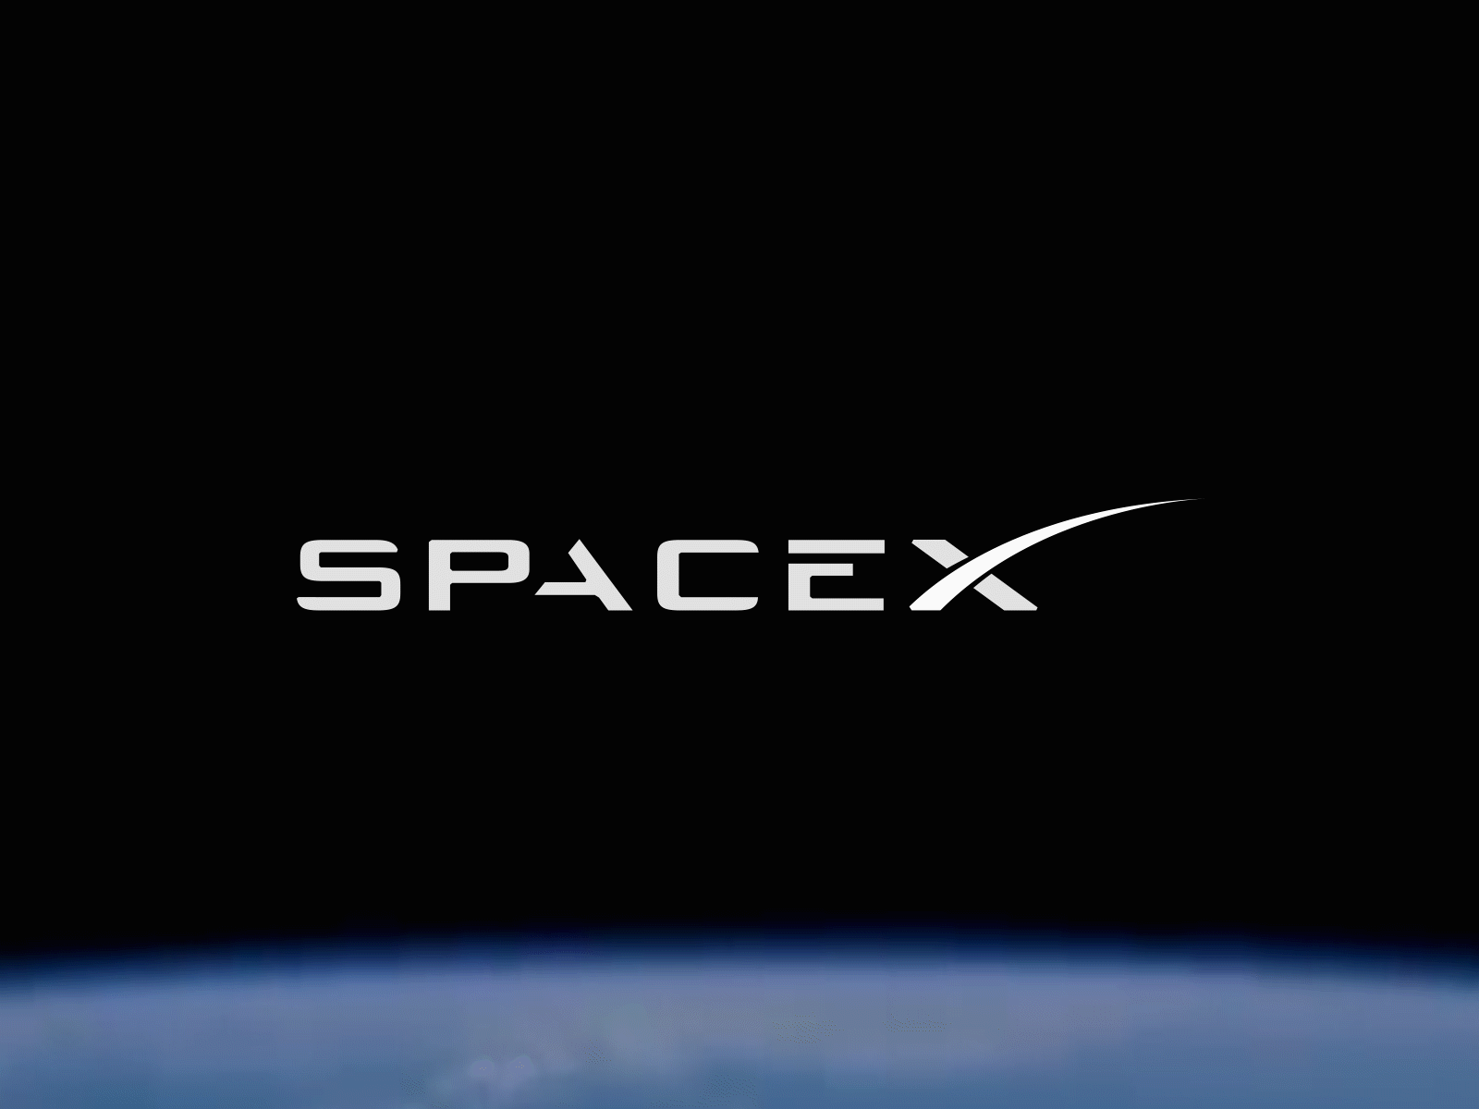

Slide 4
Starlink Project
Satellite internet constellation
Mass-Number of Small low cost satellites
Operating in LEO
Aim to provide satellite internet connectivity to underserved areas of the planet
Revenue to fund Mars Project
Plans to develop and deploy a version of the satellite communication system to serve Mars

Slide 5
Technologies Involved
Ku Band 12-18GHz (Satellite TV & VSAT)
Ka Band 26.5-40GHz (Satellite Uplinks)
E Band 60-90GHz (RF/Microwave backhaul links)
Phased array (Array of antennas)
Laser Communication (Space-to-space)
Spacecraft type: small satellite (smallsat)
Launch Vehicle: Falcon 9 Rockets (First Orbital Class Rocket Capable of Re-flight)

Slide 6
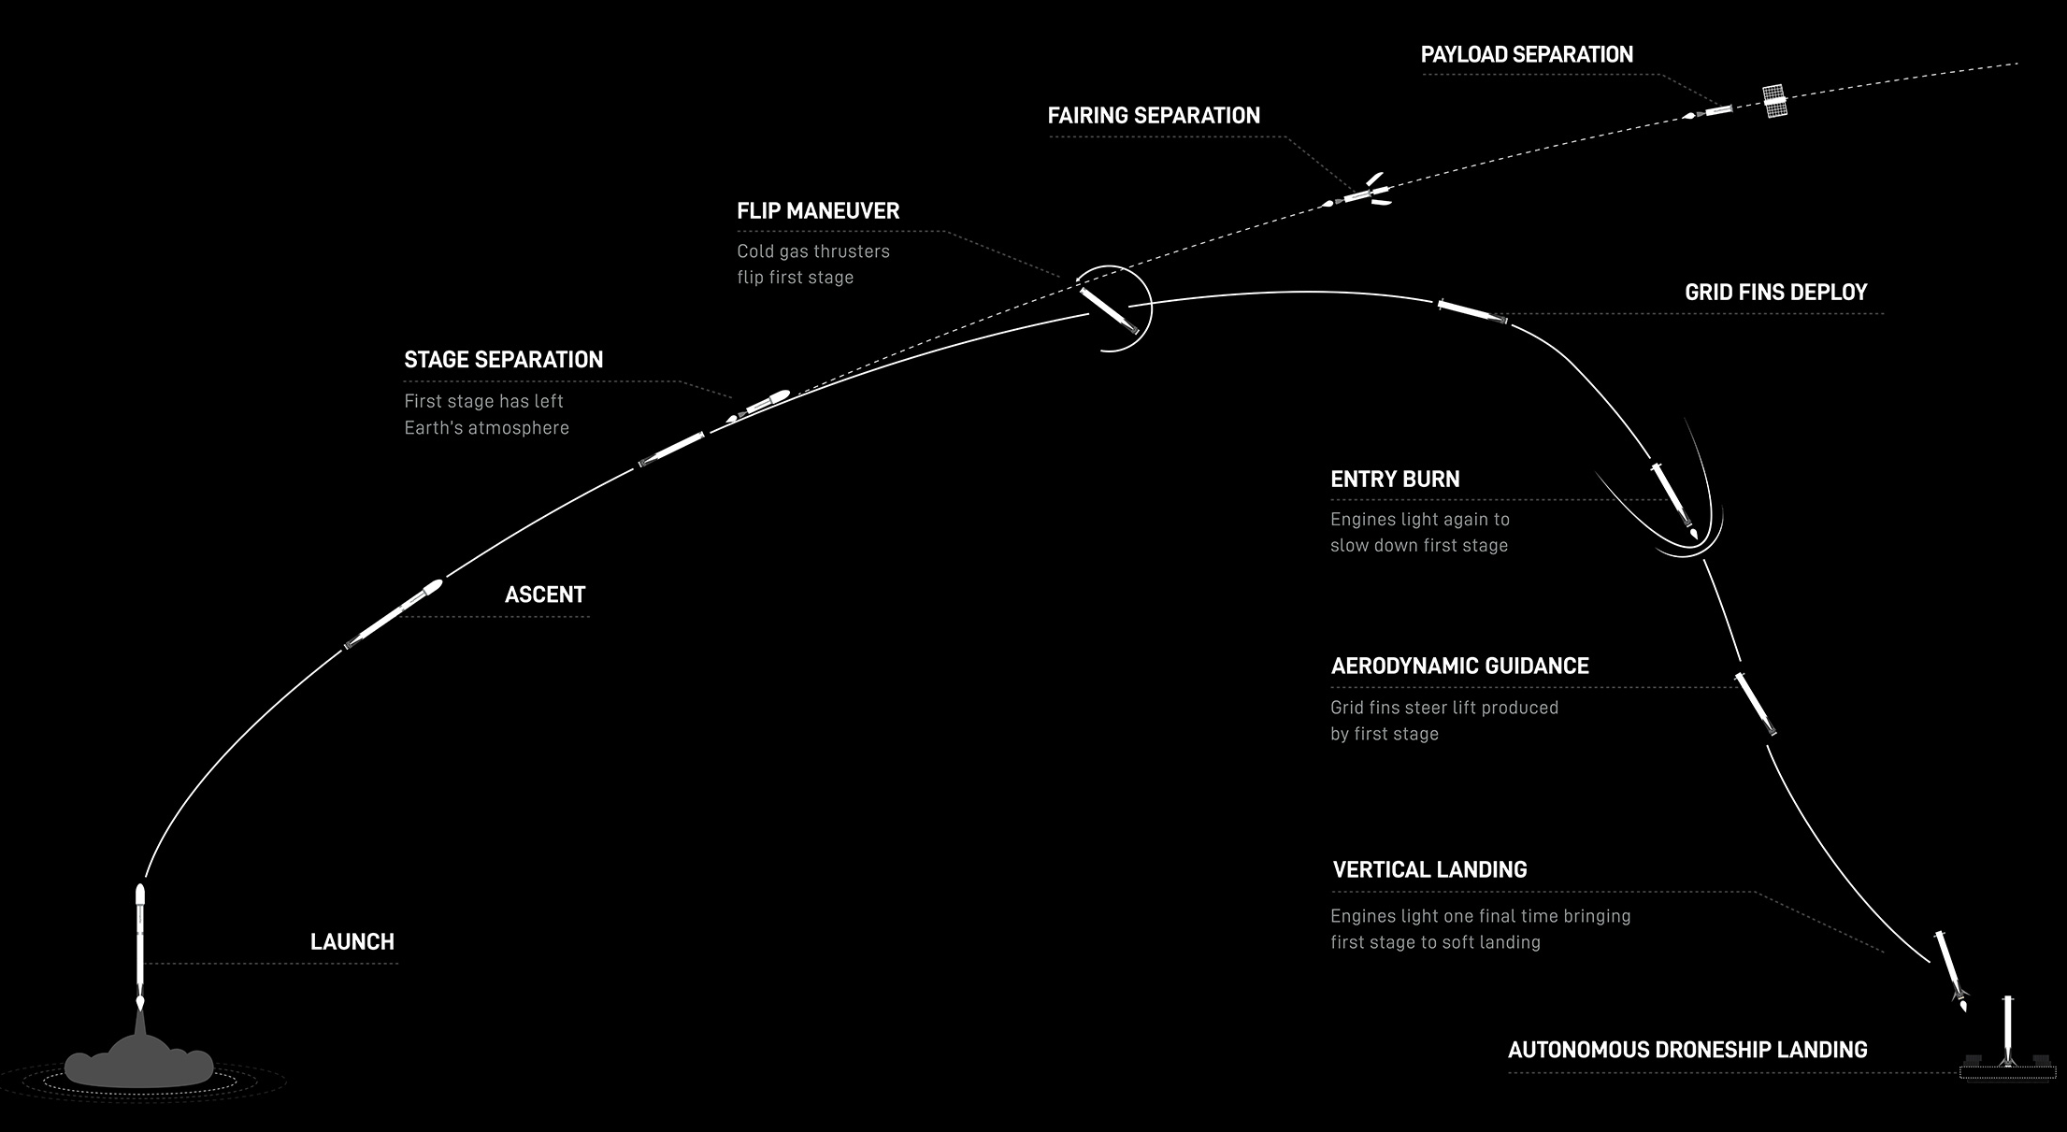
How it works?

Slide 7
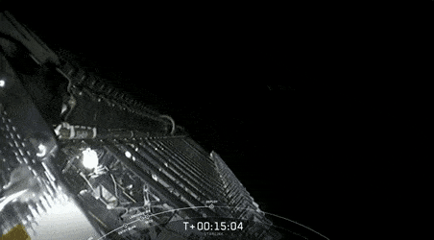
How it works? (cont.)
Satellite Deployment

Slide 8
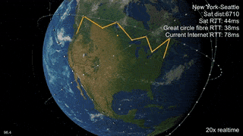
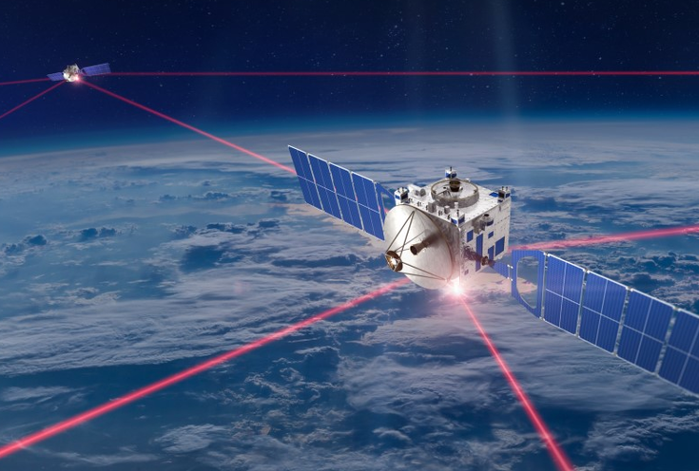
How it works? (cont.)
Post Deployment
Laser Communication

Slide 9
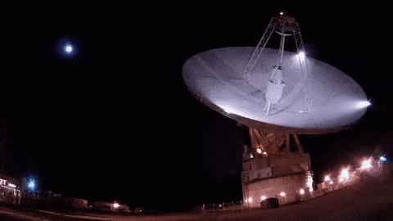
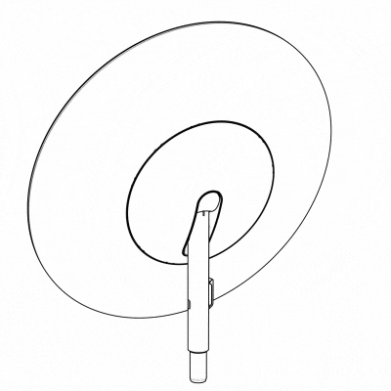
How it works? (cont.)
Ground Station
Starlink User Terminal

Slide 10
Advantages
Latency is very low
Starlink satellites are over 60 times closer to Earth
Ideally suited for areas of the globe where connectivity has typically been a challenge like Mountains, Remote Forest.

Slide 11
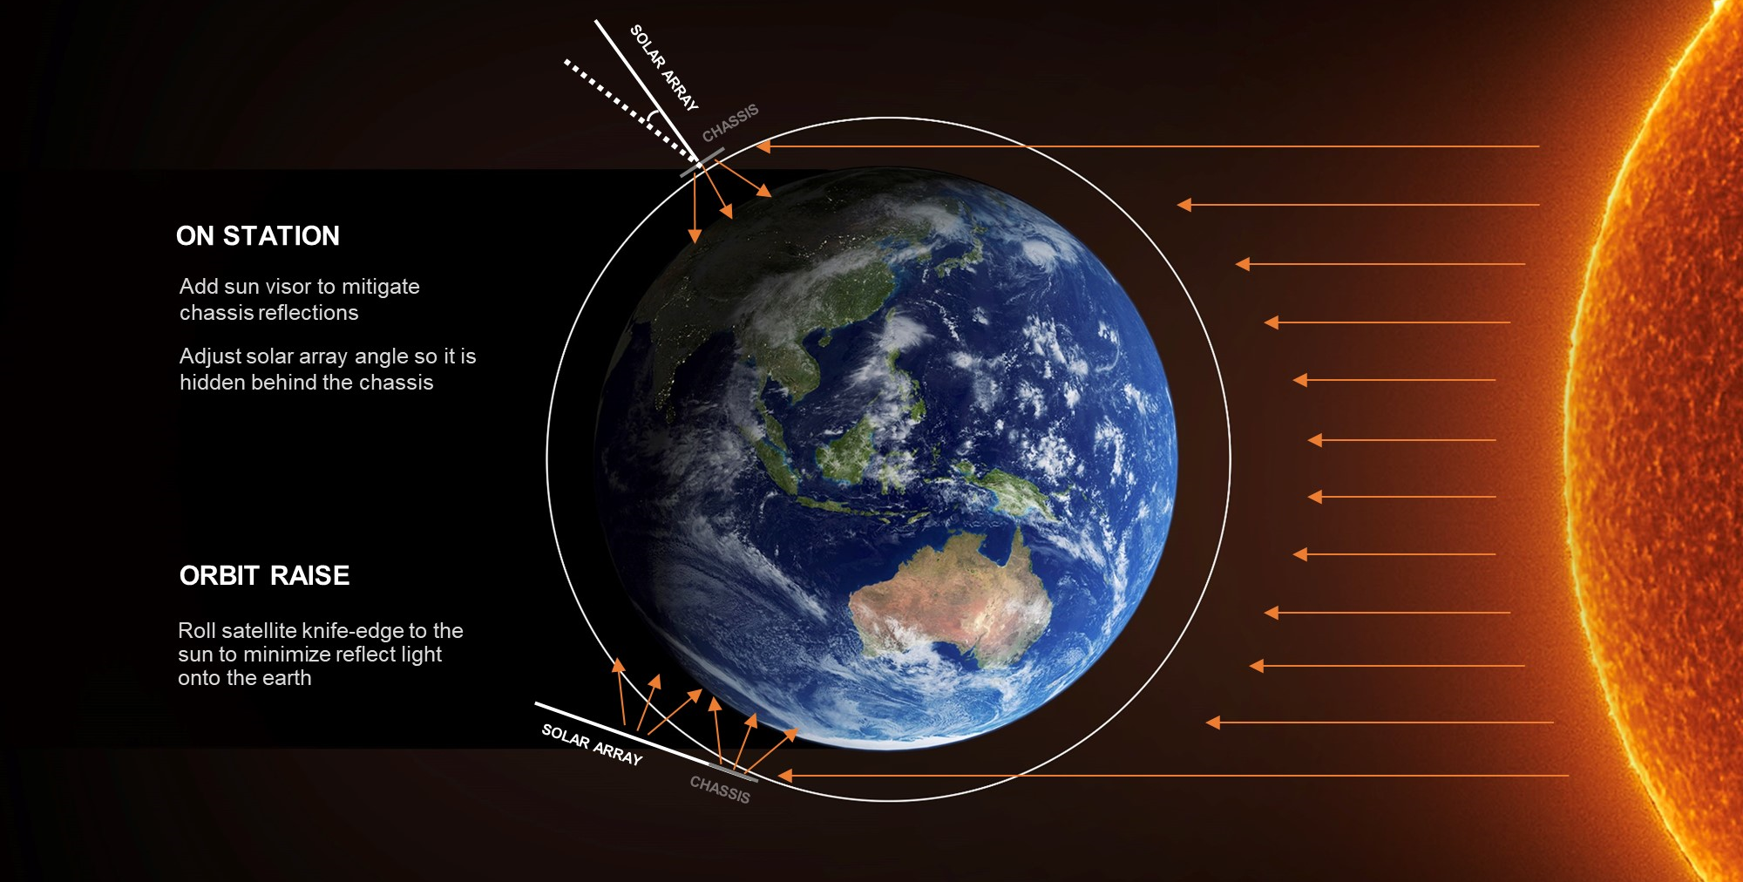
Disadvantages
Light Pollution

Slide 12
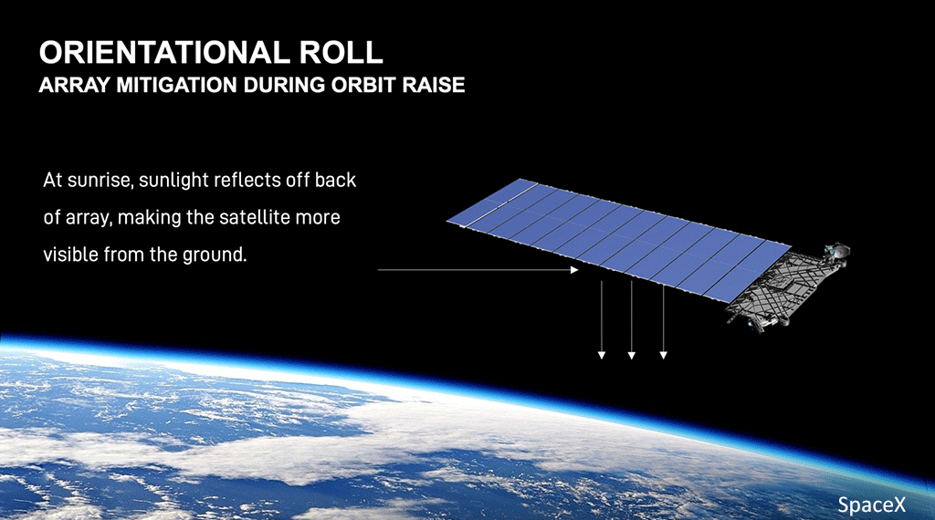
Solution Theory
ASTRONOMY DISCUSSION WITH NATIONAL ACADEMY OF SCIENCES

Slide 13
Disadvantages
Space Debris
space debris resulting from placing thousands of satellites in orbit and the risk of causing a satellite collision, causes Kessler syndrome.
SpaceX solution: Small satellites placed in lower shell (550km) when lose propulsion, Deorbit safely & burn out on re-entry to earth. Satellite Lifecycle is 5 Years after losing it’s orbit.

Slide 14
Starlink Developers Insight
C++ is most widely used Language to code software for Satellites & Spacecraft’s.
Some prototyping development in Python.
CI-CD Environment thus making it possible to mission every week.
Most SpaceX Advanced rockets use C++ for Linux Embed onboard computer software's.

Slide 15
When is it coming to India?
Currently on Beta Service for US, UK, Canada, & Australia
As Starlink is operational on 44°, 53° lat. now.
For India is in 20°, 78°lat. It is expected to provide service from 2023 beginning.
(Source Starlink Page) Preorder available @ $99.00 ~ ₹7,200/-

Slide 16
Thank You!
Next Launch: June 3 2021 1:29 PM ET | 10:30 PM IST
SpaceX Falcon 9 CRS-22 (Commercial Resupply Services). SpaceX will launch a Falcon 9 rocket to deliver supplies and research experiments to the International Space Station.

